Slide 1
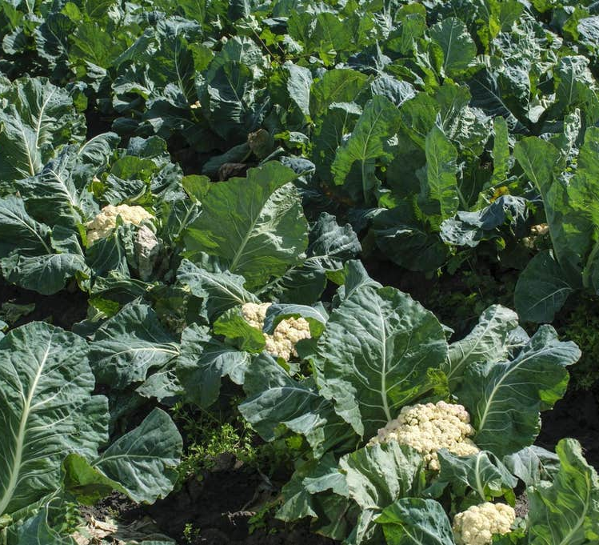
1.Arg(s) Scarcity of Cauliflower in terms of Production.
Notes:
1.In addition, which was the downfall of production of cauliflower and other crops as well, due to heavy rainfall and the flood which almost destroyed 80% of the crops of this year which was devastating for the farmers and for the people as well who uses cauliflower in home and go for restaurants as well.

Slide 2

Scarcity of Cauliflower in terms of Supply.
20%
80%
Notes:
1.As the pressing matter of production because of dogs and cat & flooding, how could the farmers will able to supply to the market. If the market is unable to get how they are going to hold their customer in the long run, it seems impossible to hold it together.
2.As this picture depiction above, during the production they lost 80% of the crops of this year. How possibly they could satisfy everyone in the country with 20% of remaining cauliflowers.

Slide 3

Scarcity of Cauliflower in terms of Price.
Notes:
1. Prices have risen from floor to the roof. However, when they need to import from some other countries like ’Holand’ which could cause extra money than usual prices.
2.If they import from other countries obviously they will be charged a bit high because of transporting from one country to another.

Slide 4
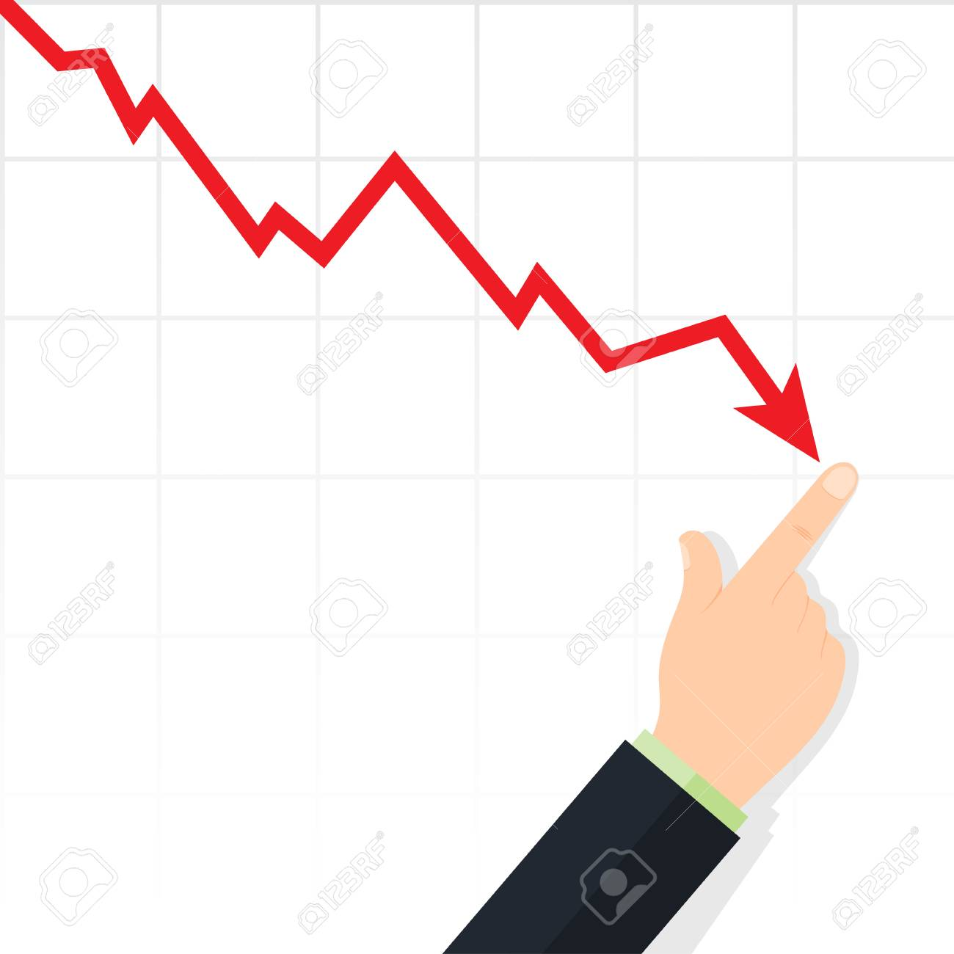
Scarcity of Cauliflower in terms of Profit.
Notes:
If they have remained with 20% of crops in the year. How is the case they can profit from 20%?
They will not able to get a reasonable profit as they usually get from the crops every year. Even if they imported from other countries they will not get any profit

Slide 5


Scarcity of Cauliflower in terms of Running Organization.
Customer
Notes:
1.As about the organization mentioned in this very article, there are some restaurants where they decided cauliflower to off from the menu from pizza and from other dishes as well. In the meantime, How could they possible to satisfy their customer with the not only absence of cauliflower but other crops as well. Likewise, cabbage, sprouts, etc. As we know all, vegetables are the main soul of zinger and other stuff as well in the restaurants.
2.For those who depend on plant-based recipe restaurants likewise. They have to remove the cauliflower from the menu or they must use another vegetable fro their organization which might not satisfy their customer totally.

Slide 6
Main Issues:
Scarcity and production:
Prices have gone up after the destruction of crops and farmers respectively lost their financial states during the rainfall.
Even they were willing to import cauliflower from other countries during the shortage.
Difficult for a chef like Deliciously Ella, who uses to make dishes with the help of a plant-based recipe.
They were lost the source of production as well during the flooding because field became mud and they were unable to produce any cauliflower and other vegetables too.
It seemed they decided the cauliflower off from the menu and substitutes other vegetables instead of cauliflower.

Slide 7
Demand and supply
Import cauliflower from some countries. (Holland)
If restaurants do not get it, they face nuisance
They were willingly to pay more than traditional money.
An alternative for reduces the use of meat in the food.
Can’t fulfil the need to everyone with 20% remaining crops.
Notes:
They decided to buy cauliflower and other ingredients from another country because of demand from community.
In case, if restaurants are unable to get cauliflower they are going to see the causes and effects of it, having demand from the community.
They were ready to pay more money rather traditional pricing as the sign of huge amount of demand
Alternative for those who reduce their intake of meat in their food.
As 80% of the crops were destroyed , so hard to supply and fulfil the need of everyone inside the country untill they import from somewhere.

Slide 8

3.Explanation of examples:
"If restaurants are unable to get their hands on cauliflower, that is obviously going to cause a nuisance.
"We have had to import them from Holland during the shortages. The growers have lost a lot of crop, so the market is very short and the price has gone up.
Notes:
Explanations:
1.In case, if restaurants are not going to get as per the customer need, there is not any doubt they will lose their customer and recognition among the market .
-Unfortunately, they will not able to make plant-based recipe food which needs cauliflower in it which causes the down in their sale and revenue and lump sum as well.
-Baes on this scenario, they will not able to maintain their organization structure in the market.
2. In the meantime, for getting rid of the current situation we need to import some services from Holland, For instance, cauliflower and etc. The farmer had lost him the financial condition they are in the critical situation that they faced during the heavy rainfall, they can not provide enough cauliflower to the market so the price has risen up.
-during their bad time, they are asking a favor from other countries to help them out in this problem.
-They lost 80% of it, they could not provide the whole country with 20% of its production.
-Although, their prices have gone high than the standard price of cauliflower.

Slide 9

Examples: Continued
"We effectively had three months of rain in the space of three days, so anything that was planted up until that point in time [including the cauliflowers and broccoli] was either washed out of the ground, or sat for several weeks in flooded fields.“
"We have lost up to 80% of our production for the last two to three weeks and the next three weeks, so a large chunk of our season we're suffering not only crop losses but financial losses as well. Incomes are down and it's going to take a lot of recovering."
Notes:
1. Rainfall of three months day and night, everything was gone in the waste. For instance, Cauliflower cabbage and etc.
-People were also get stuck in the fields having heavy rainfall during the flood.
-Nothing left in the fields when the flood came to the ground and washed everything out from the fields before their bare eyes.
2.Needless to say, they faced 80% lose of their production, not only 80% but they lose their financial state as well during the weeks of flood and rainfall over the fields,
-Likelihood was down, the source of earning was down, production was down.
-farmer who are not enough to run their household if they face such catastrophic cause during the shorage.

Slide 10
"This is yet another example of how retailers are having to manage the effects of climate change, which has created a greater variability in the weather and resulted a slightly poorer harvest in the UK."
Notes:
1. There is another side of the retailer that has to balance the effects of weather variation.
-Climate change did change farmer stability in terms of money.
-Change in the weather caused farmer and business and other stakeholders too
-Change in climate comes a change in the stability and it brings the poorer harvesting in the whole country.

